Slide 1


Monthly Meeting : April 2024
Ahmad Agus Widodo
PhD Student in Geotechnics Sections
Supervisors:
Dr Truong Le (Geotechnic Sections)
Dr Philippa J Mason (Royal School of Mines)
This PhD is funded by Indonesian Endowment Funds for Education (LPDP)

Slide 2
Outline
01 Segmentation process : general process of how to segment the data.
Ref: Shin et al. (2022)
02 Next Plan: Study Case of Crack at Folkestone Warren
Ref: Xu et al. (2021)

Slide 3
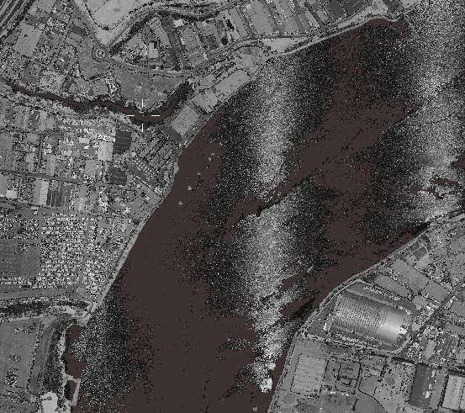
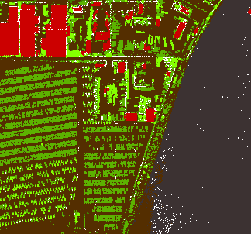
Segmentation (1)
Rooftop
Vegetation
Fence
River
unknown
Input point cloud
Select Training (red) and Test (yellow) Datasets
Labelling
(manual: CloudCompare)
Test Data
Unseen Data
Training Data
Output
PointNet++
Trained PointNet++
Accuracy Assessment
Semantic Segmentation
Inference Process
Training Process

Slide 4
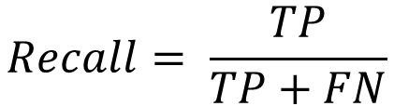
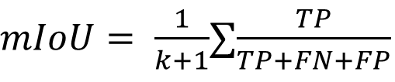
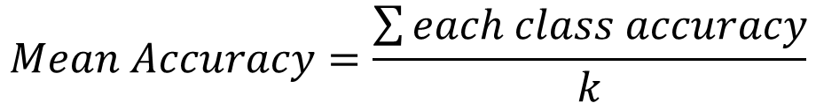
Accuracy Assessment
$$Overall Accuracy=\frac{Number of correct prediction}{Total Number of prediction}= \frac{TP+TN}{TP+TN+FP+FN}$$
$$Mean Accuracy=\frac{\sum{each class accuracy}}{k}$$
$$Intersection of Union=\frac{Area of overlap}{Area of union}=\frac{Area (Prediction ∩target)}{Area (Prediction ∪target)}= \frac{TP+TN}{TP+FP+FN}$$
$mIoU= \frac{1}{k+1}$∑$\frac{TP}{TP+FN+FP}$
$$Recall= \frac{TP}{TP+FN}$$
TP = True Positive
TN = True Negative
FP = False Positive
FN = False Negative
k = number of classes
IoU = to evaluate the performance of object detection or segmentation algorithms
recall =to evaluate DL model training performance and results of the semantic segmentation.
Notes:
True Positive (TP): This refers to the number of instances where the model correctly predicts the positive class. In other words, TP represents the number of correctly identified positive samples.
True Negative (TN): This indicates the number of instances where the model correctly predicts the negative class. TN represents the number of correctly identified negative samples.
False Positive (FP): FP refers to the number of instances where the model incorrectly predicts the positive class when the actual class is negative. In other words, FP represents the number of negative samples that are incorrectly classified as positive.
False Negative (FN): FN represents the number of instances where the model incorrectly predicts the negative class when the actual class is positive. FN represents the number of positive samples that are incorrectly classified as negative.

Slide 5
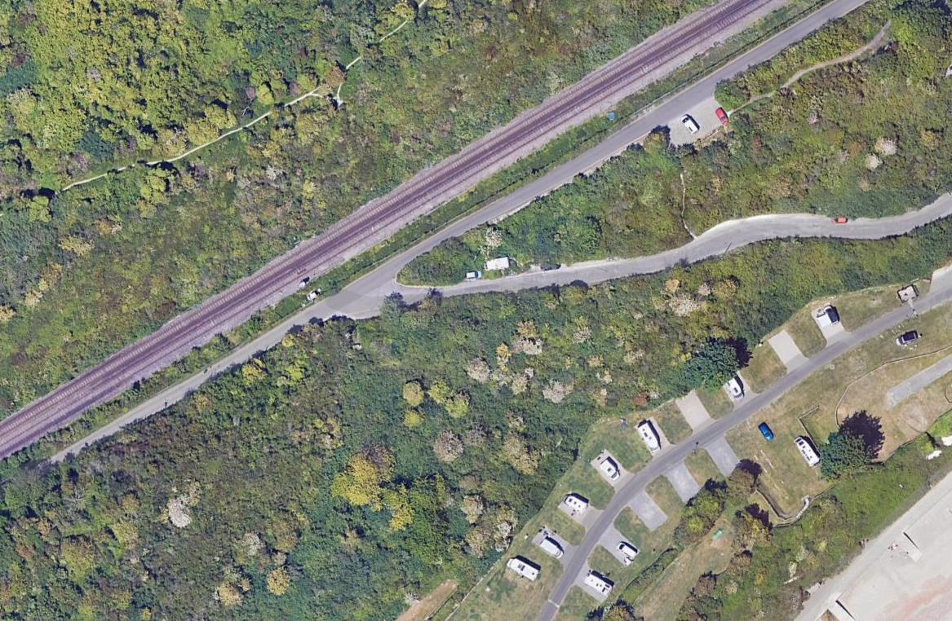
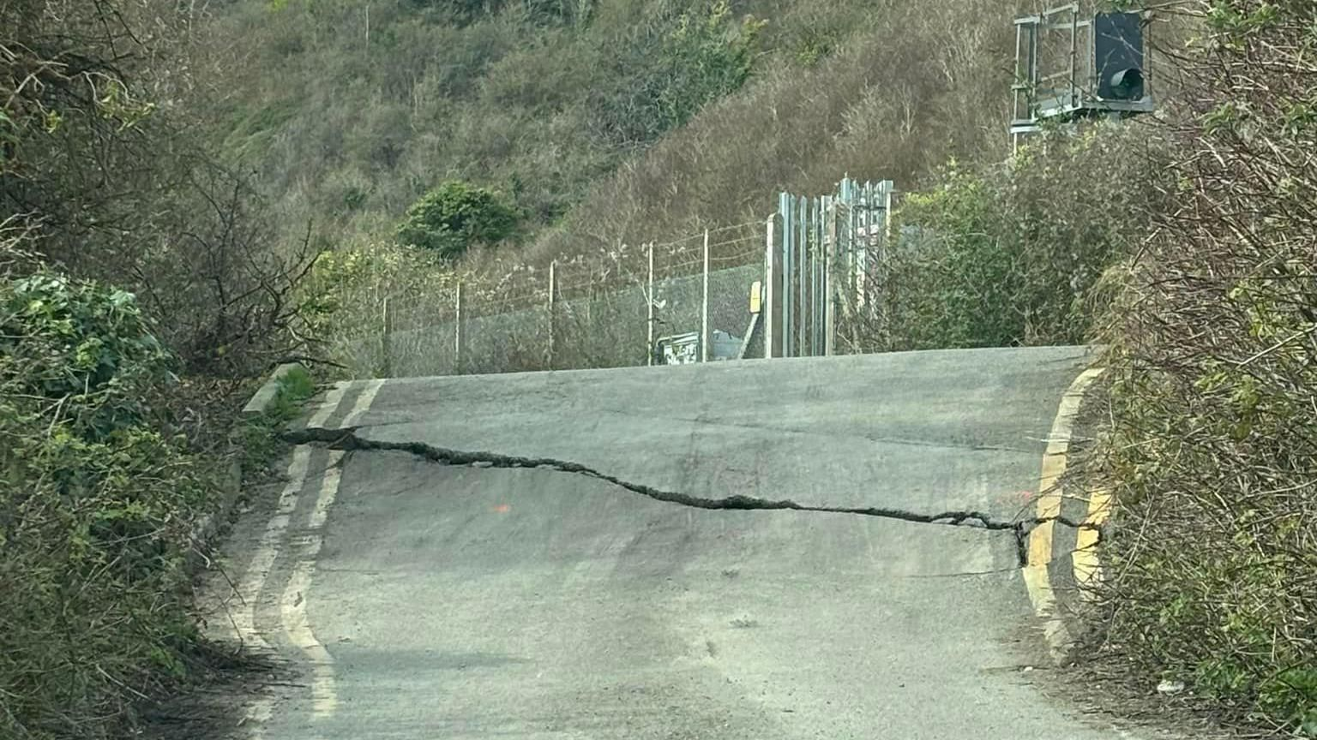
Study Area
Source Data : Google Map
Year : 2024
Location : Folkestone Warren
Source Data : Article from Network Rail aware of huge crack at Folkestone Warren - BBC News
Year : 26 March 2024
Location : Folkestone Warren

Slide 6
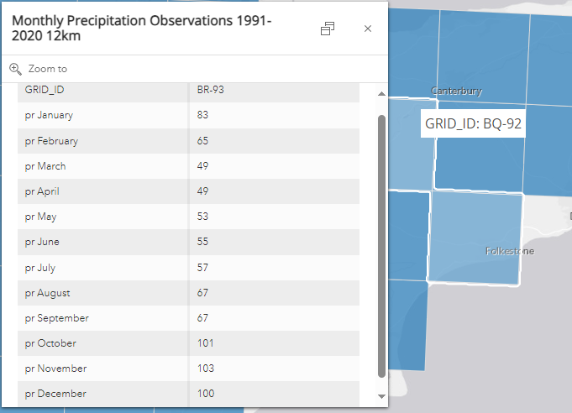
Key Point
Landslide deformation was found to be closely related to the monthly precipitation, and it presented obvious features of seasonality. In particular, deformation was obviously accelerated during the rainy season, while it significantly declined and even tended to stop during the dry season.
Source: Monthly Precipitation Observations 1991-2020 12km | Monthly Precipitation Observations 1991-2020 12km | The Met Office climate data portal

Slide 7
reference
(1) Shin, Y. H., Son, K. W., & Lee, D. C. (2022). Semantic segmentation and building extraction from airborne LiDAR data with multiple return using PointNet++. Applied Sciences, 12(4), 1975.
(2) Xu, Q., Guo, C., Dong, X., Li, W., Lu, H., Fu, H., & Liu, X. (2021). Mapping and characterizing displacements of landslides with InSAR and airborne LiDAR technologies: A case study of danba county, southwest China. Remote Sensing, 13(21), 4234.

Slide 8
CODE

Slide 9
Data Preparation
# Import Libraries
import os
import json
import random
import numpy as np
import pandas as pd
from tqdm import tqdm
from glob import glob
import tensorflow as tf
import keras
from keras import layers
import matplotlib.pyplot as plt
# Downloading and loading LiDAR dataset
# Replace dataset_url with the URL to your LiDAR dataset
dataset_url = "https://example.com/lidar_dataset.zip"
# Download and extract the dataset
# Replace the code below with your method of downloading and extracting the LiDAR dataset
# Loading the LiDAR dataset
# Modify the paths to match your dataset directory structure
dataset_dir = "/path/to/lidar_dataset"
metadata_file = os.path.join(dataset_dir, "metadata.json")
with open(metadata_file) as json_file:
metadata = json.load(json_file)
# Selecting the category (e.g., buildings) for building extraction
category = "building"
points_dir = os.path.join(dataset_dir, metadata[category]["points_directory"])
labels_dir = os.path.join(dataset_dir, metadata[category]["labels_directory"])
NUM_CLASSES = metadata[category]["num_classes"]
NUM_RETURN_TYPES = metadata[category]["num_return_types"]

Slide 10
Data Preprocessing
# Assuming point_clouds and point_cloud_labels are already loaded and formatted
NUM_SAMPLE_POINTS = 1024
BATCH_SIZE = 32
VAL_SPLIT = 0.2
# Preprocessing: Sampling and Normalizing Point Clouds
for index in tqdm(range(len(point_clouds))):
current_point_cloud = point_clouds[index]
current_label_cloud = point_cloud_labels[index]
num_points = len(current_point_cloud)
# Randomly sample fixed number of points
sampled_indices = random.sample(range(num_points), NUM_SAMPLE_POINTS)
sampled_point_cloud = current_point_cloud[sampled_indices]
sampled_label_cloud = current_label_cloud[sampled_indices]
# Normalize point cloud
norm_point_cloud = sampled_point_cloud - np.mean(sampled_point_cloud, axis=0)
norm_point_cloud /= np.max(np.linalg.norm(norm_point_cloud, axis=1))
# Update point_clouds and point_cloud_labels
point_clouds[index] = norm_point_cloud
point_cloud_labels[index] = sampled_label_cloud

Slide 11
Data Generator
# Creating TensorFlow datasets
def load_data(point_cloud_batch, label_cloud_batch):
point_cloud_batch.set_shape([NUM_SAMPLE_POINTS, 3])
label_cloud_batch.set_shape([NUM_SAMPLE_POINTS, NUM_CLASSES])
return point_cloud_batch, label_cloud_batch
def augment(point_cloud_batch, label_cloud_batch):
# Apply random jitter
noise = tf.random.uniform(tf.shape(label_cloud_batch), -0.001, 0.001, dtype=tf.float64)
point_cloud_batch += noise
return point_cloud_batch, label_cloud_batch
def generate_dataset(point_clouds, label_clouds, is_training=True):
dataset = tf.data.Dataset.from_tensor_slices((point_clouds, label_clouds))
dataset = dataset.shuffle(BATCH_SIZE * 100) if is_training else dataset
dataset = dataset.map(load_data, num_parallel_calls=tf.data.AUTOTUNE)
dataset = dataset.batch(batch_size=BATCH_SIZE)
dataset = dataset.map(augment, num_parallel_calls=tf.data.AUTOTUNE) if is_training else dataset
return dataset

Slide 12
Data Splitting
# Splitting into training and validation sets
split_index = int(len(point_clouds) * (1 - VAL_SPLIT))
train_point_clouds = point_clouds[:split_index]
train_label_clouds = point_cloud_labels[:split_index]
val_point_clouds = point_clouds[split_index:]
val_label_clouds = point_cloud_labels[split_index:]
# Printing dataset information
print("Num train point clouds:", len(train_point_clouds))
print("Num train point cloud labels:", len(train_label_clouds))
print("Num val point clouds:", len(val_point_clouds))
print("Num val point cloud labels:", len(val_label_clouds))
# Generating TensorFlow datasets
train_dataset = generate_dataset(train_point_clouds, train_label_clouds)
val_dataset = generate_dataset(val_point_clouds, val_label_clouds, is_training=False)
print("Train Dataset:", train_dataset)
print("Validation Dataset:", val_dataset)

Slide 13
Modeling
# Build model
def conv_block(x, filters, name):
x = layers.Conv1D(filters, kernel_size=1, padding="valid", name=f"{name}_conv")(x)
x = layers.BatchNormalization(name=f"{name}_batch_norm")(x)
return layers.Activation("relu", name=f"{name}_relu")(x)
def mlp_block(x, filters, name):
x = layers.Dense(filters, name=f"{name}_dense")(x)
x = layers.BatchNormalization(name=f"{name}_batch_norm")(x)
return layers.Activation("relu", name=f"{name}_relu")(x)
class OrthogonalRegularizer(keras.regularizers.Regularizer):
"""Reference: https://keras.io/examples/vision/pointnet/#build-a-model"""
def __init__(self, num_features, l2reg=0.001):
self.num_features = num_features
self.l2reg = l2reg
self.identity = keras.ops.eye(num_features)
def __call__(self, x):
x = keras.ops.reshape(x, (-1, self.num_features, self.num_features))
xxt = keras.ops.tensordot(x, x, axes=(2, 2))
xxt = keras.ops.reshape(xxt, (-1, self.num_features, self.num_features))
return keras.ops.sum(self.l2reg * keras.ops.square(xxt - self.identity))
def get_config(self):
config = super().get_config()
config.update({"num_features": self.num_features, "l2reg_strength": self.l2reg})
return config
def transformation_net(inputs, num_features, name):
"""
Reference: https://keras.io/examples/vision/pointnet/#build-a-model.
The `filters` values come from the original paper:
https://arxiv.org/abs/1612.00593.
"""
x = conv_block(inputs, filters=64, name=f"{name}_1")
x = conv_block(x, filters=128, name=f"{name}_2")
x = conv_block(x, filters=1024, name=f"{name}_3")
x = layers.GlobalMaxPooling1D()(x)
x = mlp_block(x, filters=512, name=f"{name}_1_1")
x = mlp_block(x, filters=256, name=f"{name}_2_1")
return layers.Dense(
num_features * num_features,
kernel_initializer="zeros",
bias_initializer=keras.initializers.Constant(np.eye(num_features).flatten()),
activity_regularizer=OrthogonalRegularizer(num_features),
name=f"{name}_final")(x)
def transformation_block(inputs, num_features, name):
transformed_features = transformation_net(inputs, num_features, name=name)
transformed_features = layers.Reshape((num_features, num_features))(
transformed_features
)
return layers.Dot(axes=(2, 1), name=f"{name}_mm")([inputs, transformed_features])

Slide 14
Modeling (2)
def get_shape_segmentation_model(num_points, num_classes):
input_points = keras.Input(shape=(None, 3))
# PointNet Classification Network.
transformed_inputs = transformation_block(input_points, num_features=3, name="input_transformation_block")
features_64 = conv_block(transformed_inputs, filters=64, name="features_64")
features_128_1 = conv_block(features_64, filters=128, name="features_128_1")
features_128_2 = conv_block(features_128_1, filters=128, name="features_128_2")
transformed_features = transformation_block(features_128_2, num_features=128, name="transformed_features")
features_512 = conv_block(transformed_features, filters=512, name="features_512")
features_2048 = conv_block(features_512, filters=2048, name="pre_maxpool_block")
global_features = layers.MaxPool1D(pool_size=num_points, name="global_features")(features_2048)
global_features = keras.ops.tile(global_features, [1, num_points, 1])
# Segmentation head.
segmentation_input = layers.Concatenate(name="segmentation_input")(
[features_64, features_128_1, features_128_2, transformed_features, features_512, global_features,]
)
segmentation_features = conv_block(
segmentation_input, filters=128, name="segmentation_features"
)
outputs = layers.Conv1D(
num_classes, kernel_size=1, activation="softmax", name="segmentation_head"
)(segmentation_features)
return keras.Model(input_points, outputs)

Slide 15
Training Preparation
# Instantiate the model
x, y = next(iter(train_dataset))
num_points = x.shape[1]
num_classes = y.shape[-1]
segmentation_model = get_shape_segmentation_model(num_points, num_classes)
segmentation_model.summary()
# Training setting
steps_per_epoch = total_training_examples // BATCH_SIZE
total_training_steps = steps_per_epoch * EPOCHS
print(f"Steps per epoch: {steps_per_epoch}.")
print(f"Total training steps: {total_training_steps}.")
lr_schedule = keras.optimizers.schedules.ExponentialDecay(
initial_learning_rate=0.003,
decay_steps=steps_per_epoch * 5,
decay_rate=0.5,
staircase=True,
)
steps = range(total_training_steps)
lrs = [lr_schedule(step) for step in steps]

Slide 16
Training Validation
def run_experiment(epochs):
segmentation_model = get_shape_segmentation_model(num_points, num_classes)
segmentation_model.compile(
optimizer=keras.optimizers.Adam(learning_rate=lr_schedule),
loss=keras.losses.CategoricalCrossentropy(),
metrics=["accuracy"],
)
checkpoint_filepath = "checkpoint.weights.h5"
checkpoint_callback = keras.callbacks.ModelCheckpoint(
checkpoint_filepath,
monitor="val_loss",
save_best_only=True,
save_weights_only=True,
)
history = segmentation_model.fit(
train_dataset,
validation_data=val_dataset,
epochs=epochs,
callbacks=[checkpoint_callback],
)
segmentation_model.load_weights(checkpoint_filepath)
return segmentation_model, history
segmentation_model, history = run_experiment(epochs=EPOCHS)

Slide 17
Inference Testing
# Inference
validation_batch = next(iter(val_dataset))
val_predictions = segmentation_model.predict(validation_batch[0])
print(f"Validation prediction shape: {val_predictions.shape}")
def visualize_single_point_cloud(point_clouds, label_clouds, idx):
label_map = LABELS + ["none"]
point_cloud = point_clouds[idx]
label_cloud = label_clouds[idx]
visualize_data(point_cloud, [label_map[np.argmax(label)] for label in label_cloud])
idx = np.random.choice(len(validation_batch[0]))
print(f"Index selected: {idx}")
# Plotting with ground-truth.
visualize_single_point_cloud(validation_batch[0], validation_batch[1], idx)
# Plotting with predicted labels.
visualize_single_point_cloud(validation_batch[0], val_predictions, idx)
def plot_result(item):
plt.plot(history.history[item], label=item)
plt.plot(history.history["val_" + item], label="val_" + item)
plt.xlabel("Epochs")
plt.ylabel(item)
plt.title("Train and Validation {} Over Epochs".format(item),
fontsize=14)
plt.legend()
plt.grid()
plt.show()
plot_result("loss")
plot_result("accuracy")

